Slide 1

UNINOTE
Francesco Bovi
Francesca Davidde
Valentina Ferrazzi

Slide 2


What is UNINOTE?
UNINOTE is a mobile and desktop application and aims to help university students to have a good organization of courses and information related to them (such as info about the exam modes, homework, ..). Since professors do not all use the same platform (some use Piazza, others Classroom and others e-learning), students often do not remember if a professor uses one platform rather than another. UNINOTE provides a clear university organization.

Slide 3

How UNINOTE helps students ?
UNINOTE will offer students:
• A board in which they can see the courses’ list with the respective links that refer to the platform chosen by the professor (e.g.: Piazza, Classroom, ..), the platform chosen by him for distance learning (e.g.: Google Meet, Zoom, ..) and social channels dedicated to the course (e.g.: WhatsApp, Telegram, Discord, ..);
• Weekly timetable which represents courses’ schedule;
• Map which worries about where the lecture is going to take place;
• The possibility of receiving notification few minutes before a lecture starts;
• The "student diary”: it is customized according to the courses that the student follows. This “student diary” contains folders (named with the respective course name) in which the student can save his notes (so to have them always available wherever he is);
• The opportunity to take notes on the app by providing a "notepad". Then, notes can be saved in the private course folder or can be shared with other students;
• The possibility of making reviews (expressed with a number of stars ranging from 1 to 5) to the notes shared by another colleague, so that students can share with other users how useful they are.

Slide 4
REQUIREMENT ANALYSIS

Slide 5




Competitors Analysis
Competitor 1
Data are automatically taken from university career
The tool is usable through the web but the app is only available for mobile devices
App that allows students to keep track of their votes, progress, write notes and read courses reviews
The tool is intuitive to use
Rudimentary interface for taking notes
Reminder for the deadline of university fees
Not all the universities are included
Automatically signed out from application

Slide 6

Competitors Analysis
Competitor 2
User can choose the template
The tool is usable through the web but the app is only available for mobile devices
App that allows to create workspace, take notes and share material
It provides a useful collaborative workspace
The tool is not intuitive, it needs better instructions
User can share with unlimited members
It is a very slow tool
The app is an online app, it would not work if the user is offline

Slide 7

Competitors Analysis
Competitor 3
Possibility of booking exams
The tool is usable through the web but the app is only available for mobile devices
App for Sapienza’s students that allows them to check their university career and offers a courses’ timetable
The tool is intuitive to use
Usable only by Sapienza’s students
It is a useful platform to organize courses’ lectures
Very unstable during use
Any possibility of communication between student

Slide 8






Competitors Analysis summary
 | UNINOTE | Uniwhere | Notion | Infostud
Free
Account
Courses’ Info
Student’s personal desk
Take notes
Share notes
Lecture reminder
Building map
Courses schedule

Slide 9








User Profile
PROFESSION:
Student/Working student
GENDER:
Male/Female
LOCATION:
Everywhere
AGE:
18-35 (average 27)
TECHNOLOGY:
Familiarity with smartphone and desktop application
DISABILITIES:
No specific limitation

Slide 10



Persona 1
Scenario 1
Matteo
24 years old, Latina,
student
It’s the last week of May. The second semester of the master in Physics has almost finished. Matteo is getting ready for the exam summer session.
He is a very careful and organized student and, for this reason, he has attended all the lectures and as he is used to do, he has put together all his notes in some PC folders. His desktop is full of them and there are also other private documents and private folders in it. So, he has some difficulties on checking up what he really needs.
Furthermore, next week exams will start and Matteo is studying a lot and he is doing also a lot of exercises in order to get good marks. He wants to compare his opinion with other colleagues and so he uses WhatsApp and Telegram's chats. Unfortunately, Matteo has to check if a course is associated to a WhatsApp chat or a Telegram one and he gets so annoyed wasting time!
The exam period is very important for him, therefore he has decided to stop playing tennis for a while! He gets a lot of deadlines to meet! He has to deliver final projects and he has also several meetings with the relator for questions about the degree thesis. To do not let those commitments drive him crazy, Matteo uses his calendar on mobile phone and he writes down the various appointments. Everything has to be perfectly organized!
Matteo is one of the best student of the Physics master course and he lives with his parents and his brother. He is attending his senior year and he is going to graduate on the next summer.
He is a really curious guy and he is always looking for something new to learn. He loves exchanging ideas and opinions with other students in order to keep up with the times. He thinks he has a lot to learn from other students and they can learn a lot from him too.
Matteo really loves to study and he spends a lot of time on it. He does not miss any lecture and he pays attention on everything professor says. In order to be fast, he is used to take notes on PC. It also helps him to manage his materal. Indeed, he creates a folder for each course he is attending and he saves the corrisponding notes in it.
Matteo is a sporty person: during his free time he is used to go jogging with his brother, while on Monday and on Friday he plays tennis. Sport helps him to relieve stress. He thought to give up the Tennis Club because of studies. Then he realized: it’s just a matter of finding the right balance!

Slide 11
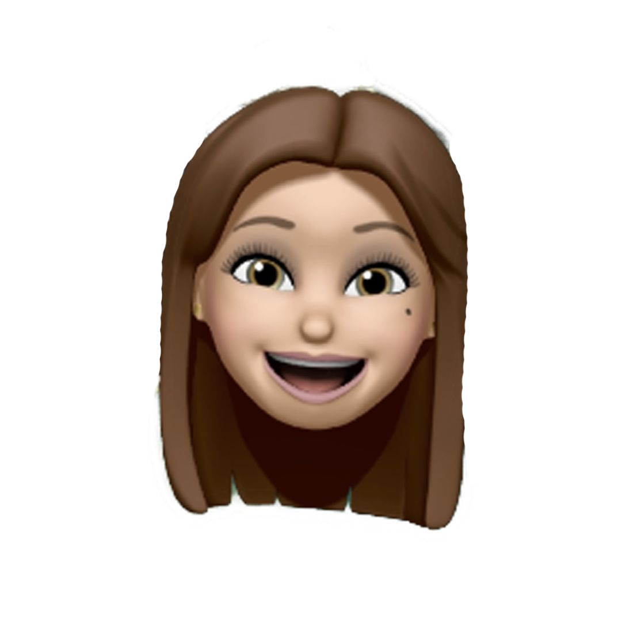
Persona 2
Scenario 2
Federica
23 years old, Rome,
part-time student, worker
It’s one of the first days of March and the second semester of the first year of Engineering in Computer Science has just started.
Federica was really excited about this new beginning, but unluckily she could not attend all the classes because she works in the morning. The first week is usually one of the most important weeks of the semester. Professors introduce their courses and they provide students important information and instructions about the organization of the course.These basic information are related to the platform used to attend lectures, the website in which students can find all the needed materials, what kind of final exam there will be and additional information about projects and homework.
Since Federica missed some first lectures, she has to check on Sapienza web site if what she needs is there. Sapienza website is not always clear, so she has to spend a lot of time on searching on professor private website or course’s pages. At the end, she has maybe collected all the information. Information are a lot: how much time she will take to memorize them?
Federica already knows her biggest problem is related to the room in which each classes will take place. She has always had trouble with them. One imagines her, being in hurry, looking for the geolocation of a room on Google Maps.
Federica is a part-time student, she lives with her parents and she is attending the master-degree in Engineering in Computer Science (Sapienza University) while she is working as Java Developer for a company.
She is really busy and she has no free-time at all. Federica really thanks her mother, who worries about everything her daughter needs. So, Federica has always her packed lunch ready! Her bedroom is always tidy, even though she doesn’t lift a finger!
Federica spends all her mornings at work and all her afternoons studying and doing university stuff. Her daily routine is really stressful: she wakes up very early, she gets ready and she goes to work. At 1 p.m she gets off and, if there are afternoon lectures on her schedule, then she attends them. Otherwise, Federica comes back home and she studies something about the morning lectures she has lost.
She is a really good student and since she cares a lot about her university career, she always tries to do her best.
Usually, she is a very neat person, she really likes to have all university notes and material well-ordered. Unfortunately, she is always in a hurry and therefore she has not so much time to organize everything she needs.

Slide 12
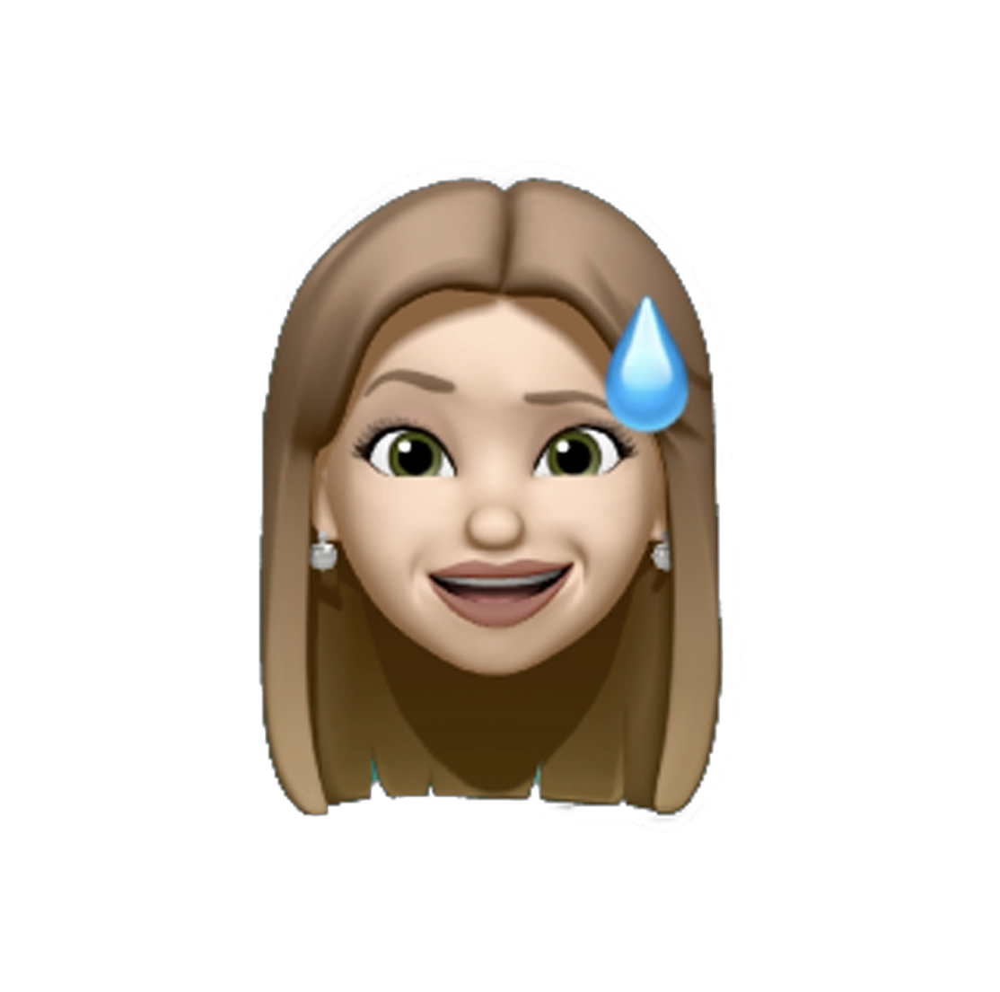
Persona 3
Scenario 3
Sara
30 years old, Tivoli,
mother, worker and part-time student
It’s 15th December morning. Christmas holidays are going to start in a few days. Sara is thinking about the Christmas’ Eve menu: this year it will take place at her house and it must be perfect! December has always been a very busy period. Ludovica is actually a really challenging girl. She is getting ready for the Christmas pageant and also for the year-end essay (dance show). So, she has many lines to learn, many extra school works to do, many ballet routines to go over. Ludovica really needs mum’s help.
Additionally, Sara should start to organize her university stuff in order to attend at least one exam on January.
After work, she drives Ludovica to the Dance School. When Sara is at home, she decides to register for the Children’s Literature exam. Then she searches the course’s summary and the slides to study. Since she has some free time, she starts to read them. The material is really bad made and it is not enough to pass the exam! There is not even a book to refer to! Sara has no colleagues at university that can suggest her how to get ready for the exam. She’d really like to consult some well-written notes! But where can she find them? There are no good notes on the web!
It’s almost time to pick up Ludovica. Giacomo is coming back from work and she has to make dinner.
Sara lights the Christmas tree and she sighs: she will look for a solution!
Sara is a 30 years old woman. She lives in Tivoli with her family which consists of her husband Giacomo, her 8 years old girl Ludovica and her lovely dog Poppy. She works as physiotherapist in Rome but she is not satisfied about her job: she would like to be a kindergarten teacher. So, the last year she has decided to start university again. She enrolled in Primary Education Science course at Sapienza University.
Whole Sara’s life is about her daughter and her family. So, she does not devote a lot of time to university stuff. She studies just when she has free time (usually at night) and she does not expect to pass too many exams during the year. After all, she is a mother, a wife, a worker and at the end she is also a student.
Sara is a cluttered person and it does not help her to manage all her daily tasks. She is that kind of person that usually forgets where she rests her phone just two minutes after she rested it! On the contrary, she is flawless about her daughter. Sara always cares about Ludovica’s life. So, Ludovica is always in time at school, she has never missed a dance lecture and she has always got good marks at school.
During the weekend, Sara loves to spend time with her family. She is used to spend summer afternoons in the garden. She lets Poppy and Ludovica play on the grass while Giacomo cooks some pancakes! A perfect family scene!

Slide 13
Questionnaire Analysis
Questionnaire’s structure
Who is answering?
Data coming from questionnaire analysis
Most of the answers come from students of “La Sapienza”;
Most of the students involved in the questionnaire are full-time students (they do not work);
The 91% of the students who answered the questionnaire need help to organize their ‘university life’;
Most of the students involved in the questionnaire follow all the lessons (or at least try their best);
Almost all the students involved in the questionnaire have problems finding classrooms;
A good percentage of the students who answered the questionnaire take notes on the computer and share them with other colleagues;
Most of the students who answered the questionnaire share their notes with other colleagues but there is no platform that prevails over the others.
How students find out information they need?
Will UNINOTE will useful?
How often do students take notes during the lessons and which tool do they use ?
How do the students communicate one with the other ?
What are the mnemonic information that a user should remember during the courses ?

Slide 14
Questionnaire’s answers
What is your gender?
How old are you?
How many years have you been attending university?
Do you live in the same site of your university?

Slide 15
Which category of student do you belong to? Remember: a part-time student is a student how has also a job.
If you are a university student, which university do you belong to? (La Sapienza, Roma Tre, Tor Vergata ,etc)
Where can you find indications about the platform (Classroom, Piazza, specific web site) used by the professor to contact his student? You can choose more than one option.
Where can you get information related to your class' schedule? You can choose more than one option

Slide 16
Where do you find the material (slides, books, recordings of the lessons, etc) that is useful to get ready for the exam? You can choose more than one option.
During this pandemic period, lessons are mostly online. How do you get the link professor uses to have lessons? You can choose more than one option
Let’s suppose there is an application that provides all this information on a unique dashboard. Could it help you with the organization?
Would you be available to collect and insert the information (platforms professors mainly use, lessons’ links, class’ schedule, ecc) in the application?

Slide 17
How often do you take notes of the retrieved information (lectures’ links, courses’ schedule, platform used by professor, etc..) ?
Do you save them using any tools, which tools do you mainly use? (e.g.: digital tool like Excel, you just write down them on a paper, etc…)
Are you aware of the existence of social channels with used to communicate with your colleagues?
If you answered "Yes" to the previous question (otherwise skip this question): How did you find out?

Slide 18
In the last year, how often did you attend lectures?
Do you have any problems on phisically reaching the classe’s room?
If yes, how do you try to solve this problem?
How often do you remember the calendar of lectures (lectures schedule) by heart?

Slide 19
How do you take notes? You can choose more than one option.
If you selected "Copybook" or "both copybook and PC/tablet", please answer the following question: Why do you take notes on your copybook rather than on PC/tablet.. ?
1 | I make a lot of schemas and so I can do them faster using a copybook
2 | Because I haven't got a personal computer always available for me
3 | I prefer to wrote on paper with a pen, I've always done in this way
4 | PC notes are faster and easier to manage
5 | It depends if I have online material or not. If I have online material, I directly take notes on it using the
6 | PC and tablet are more convenient, you can print files directly, the files are more clear to read
7 | I don't like to look always at a screen
8 | Digital notes are easier to be used
If you selected "PC/tablet" or "both copybook and PC/tablet", please answer the following question: Which kind of tool do you use to take notes (e.g.: Word, Note, ..)?

Slide 20
If you are used to share your notes: how do you share them (e.g.: Google Drive, specific application, simply using WhatsApp, etc..)?
How often do you share your notes?
If you selected "PC/tablet" or "both copybook and PC/tablet", please answer the following question: How do you organize your notes?You can choose more than one option

Slide 21
How often do you consult other colleagues’ notes?
Do you have any difficulties in finding good notes taken by other students?
How do you remember the deadline of homework/meeting/..? You can choose more than one option.
An application that notifies about an impending deadline or about the beginning of lessons could be useful?

Slide 22
TASK ANALYSIS

Slide 23
TASK 1: Select courses to join
The user looks for a new course to be added in order to:
Have its information in the homepage;
Have it included in the class schedule;
Access the shared course notes;
Write his personal notes in the course’ folder;
To search the course, he can use either the course name or the course code.
Hierarchical Task Analysis
0. Select course
Plan 0.
do in order 1, 2 and 3
1. Select join new course functionality
2. Find the course you want to join
3. Select the course from the results
Plan 1.
do 1.1
then if needed 1.2 or 1.3
then do 1.4
Plan 3.
do 3.1,
then do 3.2
then do 3.3
Plan 2.
do at least one among 2.1, 2.2, 2.3, 2.4
1.1. Enter app
1.2. Login
1.3. Sign up
1.4. Select join new course functionality
2.1. Search by the course’s name
2.2. Search by the course’s code
2.3. Search the university department
2.4. Search by the name of the professor
3.1. Look at the results
3.2. Find the course you wanted to join
3.3. Join the wanted course

Slide 24
State Transition Networks
Collecting new course data
Define search criteria
Add the new course
Go to add new course section
Your courses’ page presented
Filters shown chosen
Go back to courses’ list and search again
New course form presented
Start
Course’s details saved
All courses’ page presented
Showing all courses’ list
Insert course’s details
Start the search
Showing your courses’ list
Search resutls page opened
Select course you want to join
Go to all courses list
Waiting for selection
Your courses’ page presented
All courses page presented
Homepage
Go back to all courses’ list
All courses’ page presented
Finish

Slide 25
TASK 2: Manage course’s notifications
The user manages notifications’ course in order to:
Be or not to be notified about the beginning of the lessons;
Be or not to be notified about the homework’s deadlines;
Be or not to be notified about exam’s events;
To manage the course’s notification, he before has to select the course and then activate or deactivate the wanted notifications.
Hierarchical Task Analysis
0. Manage course’s notifications
Plan 0.
do in order 1, 2 and 3
1. Go to your courses
2. Select the course you want to manage notification
3. Activate/Disactivate notifications
Plan 1.
do 1.1
then if needed 1.2 or 1.3
Then do 1.4
Plan 3.
Do many as time as needed:
In order 3.1, 3.2
In order 3.3, 3.4
Plan 2.
do in order 2.1, 2.2, 2.3
1.1. Enter app
1.2. Login
1.3. Sign up
1.4. Go to your courses list
2.1. Look at your courses’ list
2.2. Find the course you want to manage notifications
2.3. Go to the notification managment of that course
3.1. Select notification’s type you want to activate
3.2. Activate that notification
3.3. Select notification’s type you want to deactivate
3.4. Deacativate that notification

Slide 26
State Transition Networks
Activate/deactivate lessons’ notifications
Close notification’s area
Lessons’ notifications activated/deactivated
Notifications’ area closed
Homepage
Go to your courses list
your courses page presented
Showing your courses’ list
Open the notifications’ area for the course you want
Showing notifications’ area
Notifications’ area opened
Exams’ notifications activated/
deactivated
Start
Finish
Deadlines’ notifications activated/
deactivated
Activate/deactivate exams’ notifications
Activate/deactivate deadlines’ notifications

Slide 27
TASK 3: Take-Share Notes
The user wants to take notes using the application in order to:
Write them in a clearer and more orderly way;
Always have them at hand using smartphone or PC;
Share them with the other colleagues;
To manage this he first goes to the section «Take Note», then once the note is written he can decide to share it or not, he can also
decide to share it later.
Hierarchical Task Analysis
0. Takes-share notes
Plan 0.
do in order 1, 2 and 3
1. Select the Take Note funcionality
2. Write your note
3. Save notes
Plan 2.
do 2.1, 2.2,2.3
In which order you prefer and how many times you want
Plan 3.
do 3.1
If wanted do 3.2
Plan 1.
do 1.1
then if needed 1.2 or 1.3
1.1. Enter app
1.2. Login
1.3. Sign up
1.4 Select the Take Note functionality
2.1. Type Note
2.2. Add elements (graph, image, and so on)
2.3. Edit note’s style
3.1. Choose the directory in which save the note
3.2. Share the note with other users

Slide 28
State Transition Networks
Go back to type notes
Take notes page presented
Add element (e.g graph, image, …)
Start
Element added
Typing notes
Notes
updated
Go to take notes section
Acquiring information from the user
Select course folder
Homepage
Select save notes
Waiting for the folder’s selection
Showing saving option
Take notes page presented
Save options presented
Save option presented
Choose to leave the section
Edit notes style
Homepage presented
Choose if share it or not
Choose to remain in the note section
Style edited
Note save confirmation presented
Previous note presented
Go back to homepage
Confirmation pop-up presented
Waiting for confirmation
Taken notes page presented
Finish
Go back to type notes

Slide 29
TASK 4: Find-Rank Notes
The user wants to search notes already taken by other students on the application in order to:
Find good notes shared by his colleagues;
Always have them at hand using smartphone or PC;
Rank them so that he can share with other users how useful they are;
In order to find notes, the user at first has to go to the section Shared Notes, then he searches the notes by applying some filters. Once he finds the notes he was looking for, he can mark them and/or save them.
Hierarchical Task Analysis
0. Find-Rank notes
Plan 0.
do in order 1, 2 and 3
1. Go to the shared notes
2. Find the notes you were looking for
3. Select the notes of your interest
Plan 3.
do 3.1
do 3.2 and if wanted 3.3 also in any order
if wanted do 3.4
Plan 1.
do 1.1
then if needed 1.2 or 1.3
then do 1.4
Plan 2.
do any of 2.1, 2.2, 2.3, 2.4 in any order
1.1. Enter app
1.2. Login
1.3. Sign up
1.4. Go to the shared notes
2.1. Search by course name
2.2. Search by author
2.3. Search by topic
2.4. Search by date
3.1. Click on the notes you want to consult
3.2. Read them
3.3. Save or download them
3.4. Decide if mark them or not

Slide 30
State Transition Networks
Define search criteria
Download the note
Go back to shared notes section and search again
Save the note
Filters shown chosen
Saved
Shared notes page presented
Downloaded
Homepage
Go to shared notes section
Shared notes page presented
Showing shared notes
Start the search
Waiting for selection
Select notes you prefer
Showing notes content
Search results page opened
Notes page presented
Note’s rating value uploaded
Go back to shared notes section
Shared notes page presented
Start
Finish
Rate the note

Slide 31
TASK 5: Add course information (only for the administrator)
The user (administrator of a course) wants add or change course’s information related to:
Course’s website;
Social channels students usually use to talks about the course;
Link for the online lessons;
Course’s lessons schedule
Deadlines;
In order to do that, a student has to be the administrator of the course. He has to select the course he wants to manage information, edit the course’s information and save changes.
Hierarchical Task Analysis
0. Add or change course information
Plan 0.
do in order 1, 2
If needed do 3
1. Go to your courses list
Plan 1.
do 1.1
then if needed 1.2 or 1.3
Then do 1.4
2. Active edit mode for the coruse you want to change information
3. Change/Add course’s information
Plan 2.
do in order 2.1, 2.2, 2.3,
Plan 3.
do in any order you want and if needed 3.1, 3.2, 3.3, 3.4 and 3.5
1.1. Enter app
1.2. Login
1.3. Sign up
1.4 Go to your courses list
2.1. Look at your courses’ list
2.2. Find the course you want to manage information
2.3. Select edit mode for that course
3.1. Change or Add course Website
3.2. Change or Add info about reference material
3.3. Change or Add info for online lessons
3.4. Change or Add course’s lessons schedule
3.5. Change or Add a exam date

Slide 32
State Transition Networks
Change info (e.g. schedule, website, …)
Info changed
Add new info
New info added
Go to the courses page
Select the course
Acquiring information from the user
Homepage
Showing user’s courses list
Courses page presented
Course’s info presented
Save changes
Save confirmation presented
Go back to the courses list and select another course
Start
Finish
Courses list presented

Slide 33
PROTOTYPE 0

Slide 34
Access the system

Slide 35
My courses list

Slide 36
More functionalities

Slide 37
Notes management

Slide 38
Account management

Slide 39
Desktop functionalities

Slide 40
EXPERT BASED EVALUATION Cognitive Walkthrough

Slide 41
Cognitive Walkthrough: Select course to join (present in the courses list)
Task: Add the course Human-Computer Interaction to your couses list.
Hypothesis: the student is already logged and he wants to join the Human-Computer Interaction course to his courses list. Let’s also suppose that the Human-Computer Interaction course is present in the courses list from which the user can choose from.
Action 1: Press the button “Join a new course” in the “My Courses” page.
Response 1: The system shows you the courses list in the “Courses list” page.
Action 2: Scroll the courses list in the page “Courses list” until you find the Human-Computer Interaction course. You can also search by typing the name/code of the course in the input text area.
Response 2: The system shows you the Human-Computer Interaction’s box.
Action 3: Click on the “+” symbol near the name of the course in order to add this course to your courses list.
Response 3: The systems adds the Human-Computer Interaction course in your courses list.

Slide 42
Corrections made after the Cognitive Evaluation
Courses list page

Slide 43
Cognitive Walkthrough: Select course to join (not present in the courses list)
Task: Add the Human-Computer Interaction course to your couses list.
Hypothesis: the student is already logged and he wants to join the Human-Computer Interaction course to his courses list. Let’s also suppose that the Human-Computer Interaction course is not present in the courses list from which the user can choose from.
Action 1: Press the button “Join a new course” in the “My Courses” page.
Response 1: The system shows you the courses list in the “Courses list” page.
Action 2: Scroll the courses list in the page “Courses list” until you find the Human-Computer Interaction course. You can also search by typing the name/code of the course in the input text area.
Response 2: The system does not show you the course of your interest because it is not present in the courses list.
Action 3: Since you do not find the course of your interest, click on “Add new course” button.
Response 3: The system shows you the “Add new course” page.
Action 4: Fill the form with all the infos about the course of Human-Computer Interaction.
Response 4: The system shows you the filled form.
Action 5: Click the “Add” button in order to save changes.
Response 5: The systems adds the new course in the courses list.
Action 6: Scroll the courses list in the page “Courses list” and search the Human-Computer Interaction course, which you have already added.
Response 6: The systems shows you the Human-Computer Interaction box.
Action 7: Click on the “+” symbol near the name of the course in order to add this course to your courses list.
Response 7: The systems adds the Human-Computer Interaction to your courses list.

Slide 44
Corrections made after the Cognitive Evaluation
Add new course page

Slide 45
Cognitive Walkthrough: Manage course’s notifications
Task: Switch on lessons’ notifications for the Human-Computer Interaction course.
Hypothesis: the student is already logged and he has the Human-Computer Interaction course among his course’s list. Let’s also suppose the course is not directly visible but the user has to search it. The lessonsHuman-Computer Interaction ’ notifications for this course are not active.
Action1: Press ‘’My courses’’ button from the navigation bar.
Response 1: The system shows your courses’ list.
Action 2: Scroll the courses list or click on the search field and type the name of the course Human-Computer Interaction.
Response 2: The system shows you the Human-Computer Interaction course’s box.
Action 3: Click on the bell button inside the Human-Computer Interaction course’s box.
Response 3: The system shows you the notifications menu.
Action 4: Click on the on/off button for the lessons’ notifications.
Response 4: The system activates the lessons’ notitifactions for the Human-Computer Interaction course.

Slide 46
Cognitive Walkthrough: Share notes (on mobile)
Task: Share a note regarding the course of Human-Computer Interaction to everyone following the course.
Hypothesis: the student is already logged and he wants to share a note of the Human-Computer Interaction course to his classmates. Let’s also suppose that the note doesn’t need to be modified but it was already uploaded previously.
Action 1: Select the Human-Computer Interaction folder on “My Notes” page.
Response 1: The system shows you the notes list in the Human-Computer Interaction notes page.
Action 2: Search and select the note in the page Human-Computer Interaction page that you want to share, you can also search applying filters or by typing in the text area.
Response 2: The system shows you the page of the note you selected.
Action 3: Click on the “Share” button on the bottom of the page in order to share the note with the other classmates in the “Shared notes” section.
Response 3: The systems adds the note in the proper folder in the “Shared notes” and the botton “Share” is disabled.

Slide 47
Cognitive Walkthrough: Take note (on desktop)
Task: Take a new note regarding the course of Human-Computer Interaction directly using the desktop application.
Hypothesis: the student is already logged and he wants to create a new note of the Human-Computer Interaction course. Let’s suppose the user wants to add also a graph, we suppose also that the user wants to keep the note private.
Action 1: Press the “Take note” button on the navigation bar.
Response 1: The system shows you the “Take note” page in which the user can take his notes (with pre-configured data).
Action 2: Type the notes in the proper section.
Response 2: The system will update the section with the digits typed by the user.
Action 3: Click on the graph icon in order to insert a graph in the note section.
Response 3: The system will insert the selected element in the note section on the right.
Action 4: Once finished to write the note click on the “Check” symbol to save the note.
Response 4: The system will show a message in which asks if the note must be shared or not.
Action 5: Click on “No keep it private” box.
Response 5: The system will save the note and put in “My notes” section in the Human-Computer Interaction folder.

Slide 48
Cognitive Walkthrough: Find-Rank note (on mobile)
Task: Find a shared note regarding the course of Human-Computer Interaction and rank it.
Hypothesis: the student is already logged and he wants to find a note of the Human-Computer Interaction course. Let’s also suppose that the user already knows about the existence of shared notes of the course and also the fact that the user will give 2/3 as feedback of the note.
Action 1: Select the Human-Computer Interaction folder on “Share Notes” page.
Response 1: The system shows you the shared notes list in the Human-Computer Interaction notes page.
Action 2: Search and select the shared note in the page Human-Computer Interaction page that you want to share, you can also search applying filters or by typing in the text area.
Response 2: The system shows you the page of the note you selected.
Action 3: Click on one of the “second star“ buttons on the bottom of the page in order to give a rank of the shared note.
Response 3: The systems fills 2 stars and will add the user’s rank in order to update the average rank of the note in the page of the shared notes of the Human-Computer Interaction folder.

Slide 49
PROTOTYPE 1

Slide 50
Corrections made after the Cognitive Evaluation: second prototype
Courses list page

Slide 51
Corrections made after the Cognitive Evaluation: second prototype
Add new course page

Slide 52
EXPERT BASED EVALUATION Heuristic Evaluation

Slide 53
Heuristics used
Visibility of system status
Match between the system and the real world
User control and freedom
Consistency and standards
Error prevention
Recognition rather than recall
Flexibility and efficiency of use
Aesthetic and minimalist design
Help users recognize, diagnose and recover from errors
Help and documentation
Severity rating scale
0 = I don’t agree that this is a usability problem at all
1 = Cosmetic problem only
2 = Minor usability problem
3 = Major usability problem
4 = Usability catastrophe
Heuristic Evaluation
Evaluation
Frame | Heuristic violated | Severity | Description / Comment
My courses | Error prevention | 3 | Make clear how to start the search
My courses | Aesthetic and minimalist design | 2 | The page is full of information. Consider to prioritize relevant information and use hierarchy
Edit note | Error prevention | 3 | Consider to add a confirmation message

Slide 54
PROTOTYPE 2

Slide 55
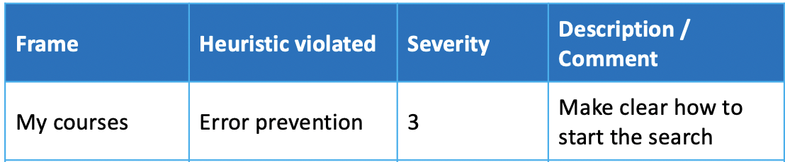
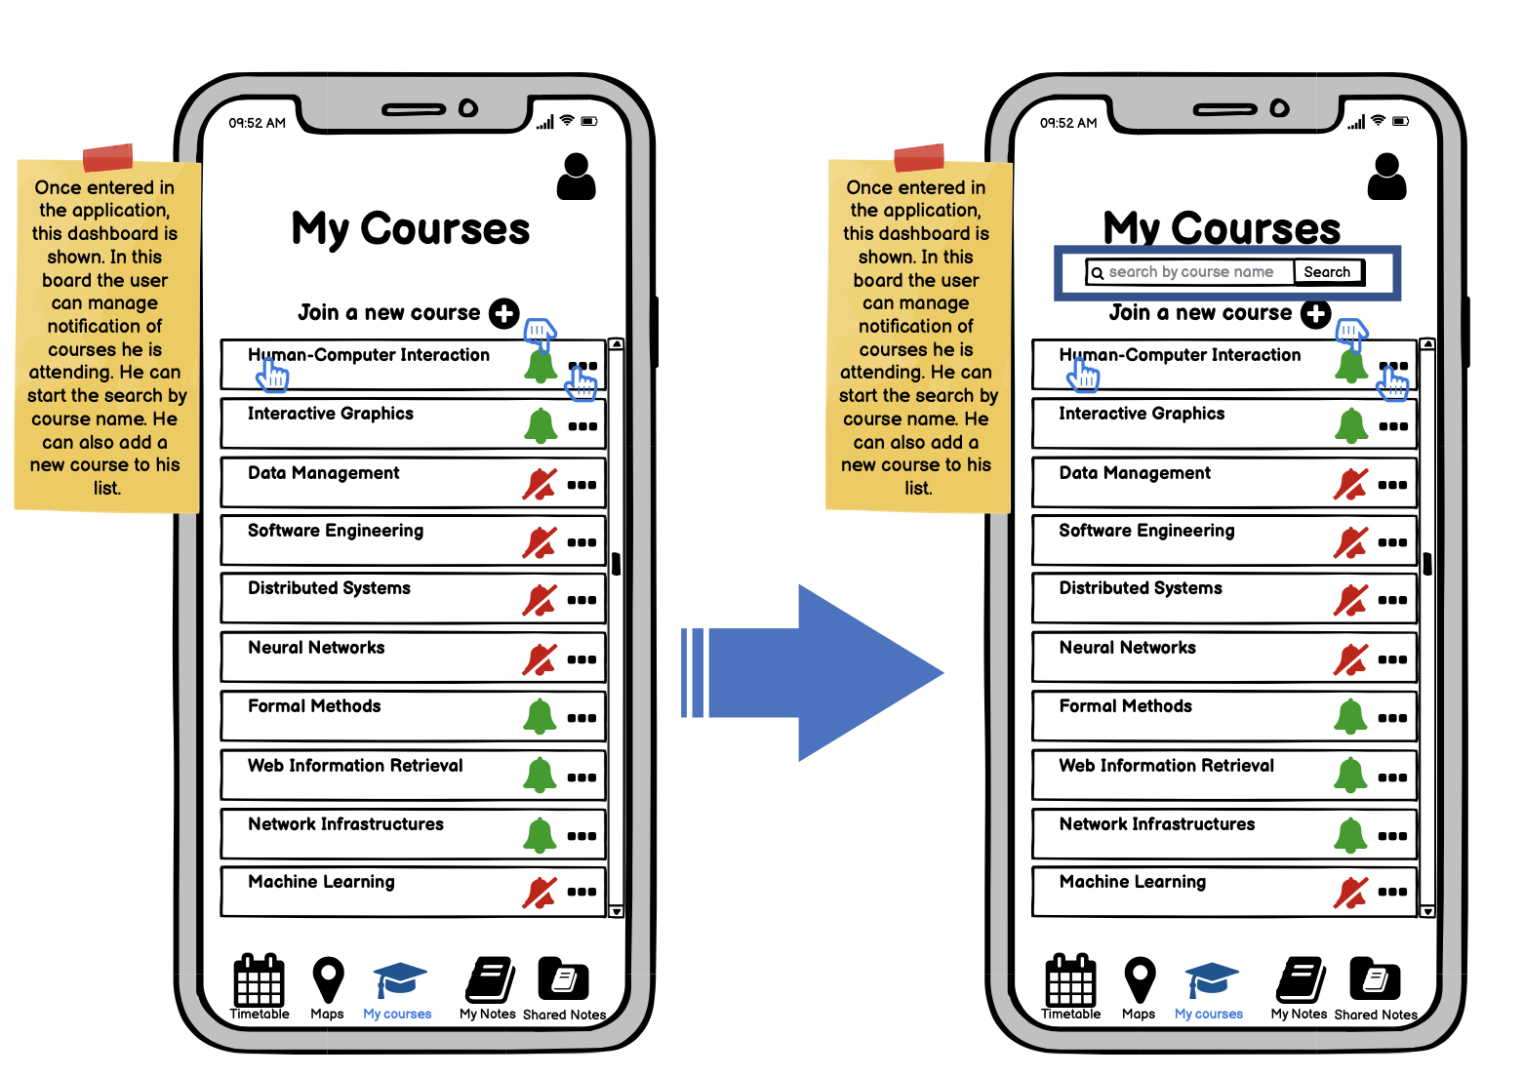
Corrections made after the Heuristic Evaluation: third prototype
MyCourses page

Slide 56
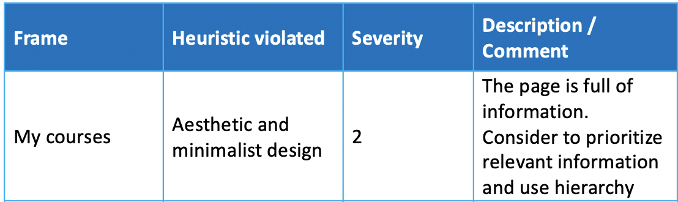
Corrections made after the Heuristic Evaluation: third prototype
MyCourses page

Slide 57
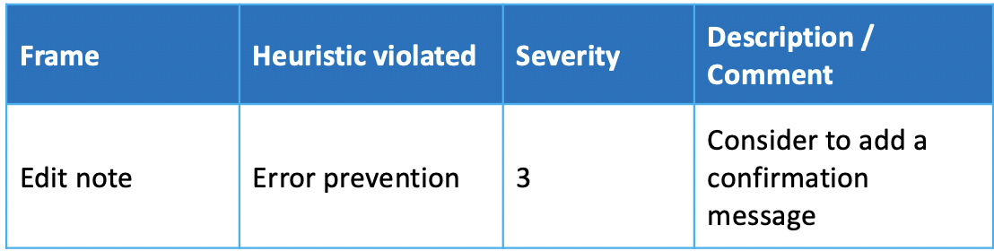
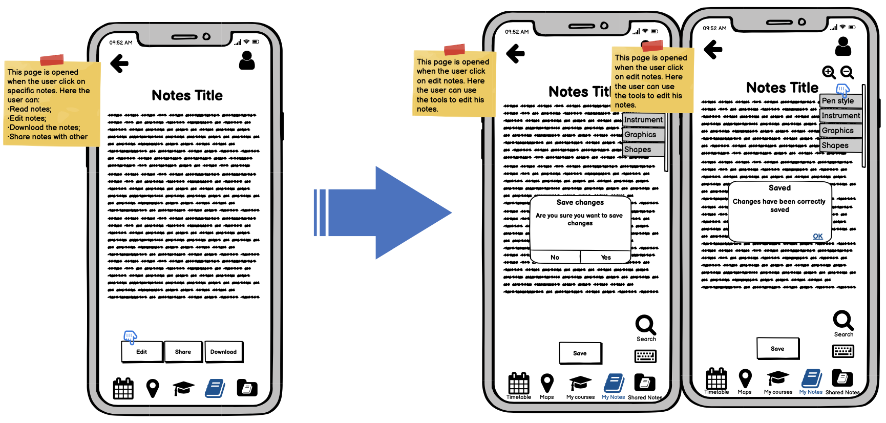
Corrections made after the Heuristic Evaluation: third prototype
Edit note page

Slide 58
USER BASED EVALUATION

Slide 59
Think Aloud
Task 1: The new semester has just begun, you need to know what is the Data Management course’s web page in order to read the professor communications.
 | Related incidents | Priority | Description | Reason | Good or bad | Solution
Finding the Data Management course | none |  |  |  | Good
Open the Data Management course details | none | 1 | User had difficulties into open the course details | It is not so intuitive to click on the course name | Bad | Make the course name a link or a button
Use the needed information | none | 1 | The user was undecided on what link to click | There are several links and not so detailed labels | Bad | Add some more info or make the existing labels more detailed

Slide 60
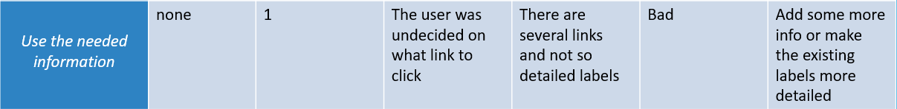
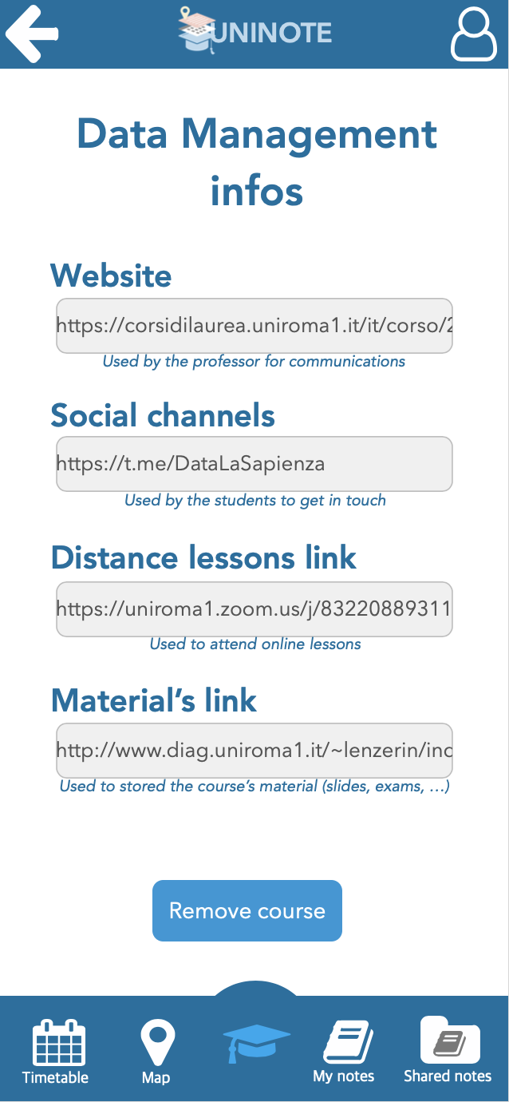


Slide 61
Think Aloud
Task 2: The lesson session is just started, you want to check the timetable of the courses to attend
 | Related incidents | Priority | Description | Reason | Good or bad | Solution
Finding the timetable | none |  |  |  | Good
Use the needed information | none | 4 | The user had difficulties in reading the courses names | The timetable of all the week lies in a single page, so very little text | Bad | Create a wider and scrollable timetable to have bigger text

Slide 62
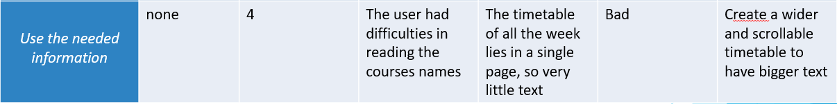
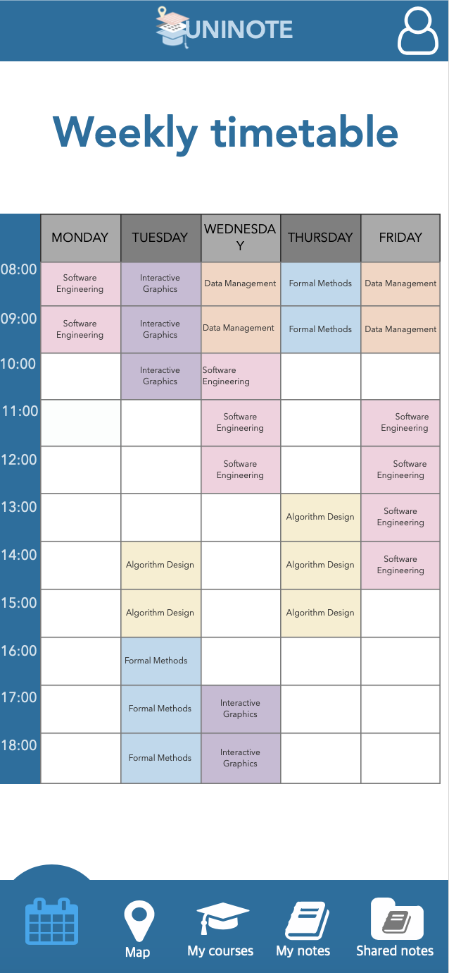
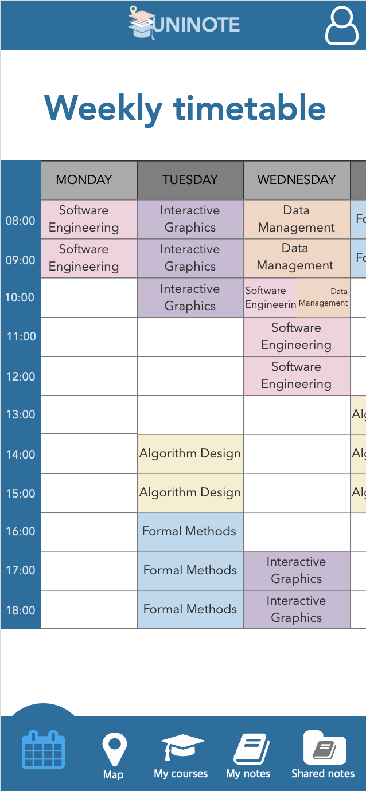
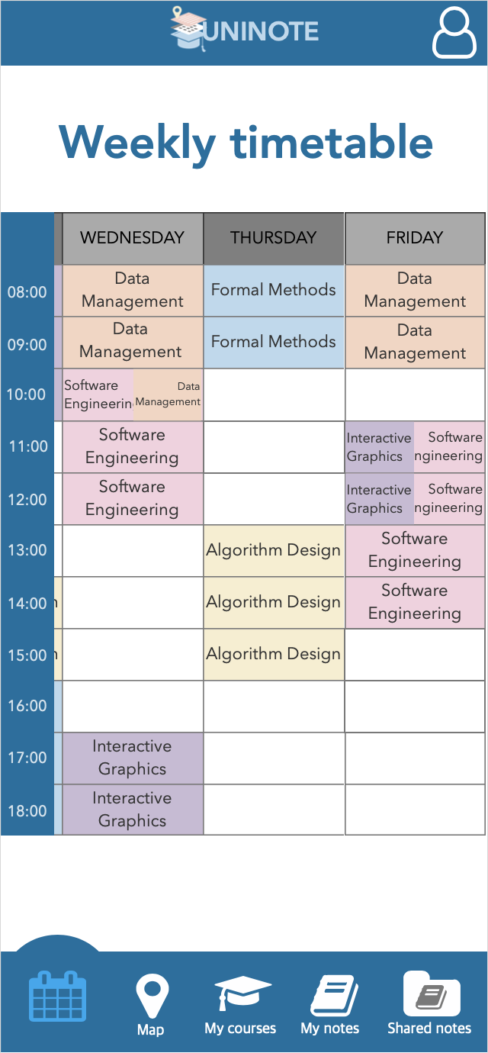

Slide 63
Cooperative Evaluation
Task 1: You have just found a good note. You want to save it as favourite and then open it from the My Favourite courses’ list.
 | Related incidents | Priority | Description | Reason | Good or bad | Solution
Save the note as a favourite one | none |  |  |  | Good
Open the My favourite course’s list | none | 4 | User had difficulties into access the My Favourite list: Where the notes has been saved? Where I can find the My favourite list? | The system provides any info about where the notes has been saved. The My Favourite list is only accessible from the Shared Notes section and the user may do not remember it. | Bad | Make the popup more detailed. Instead of ” the notes has been correctly saved” tell the user where the notes has been saved and provide some info to help the user to access the My Favourite list
Find the desired notes | none |  |  |  | Good

Slide 64
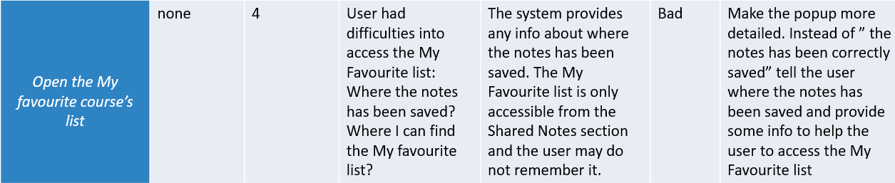
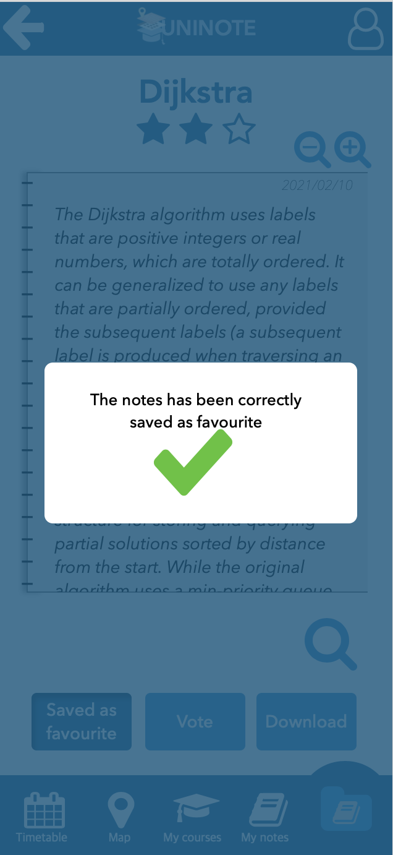
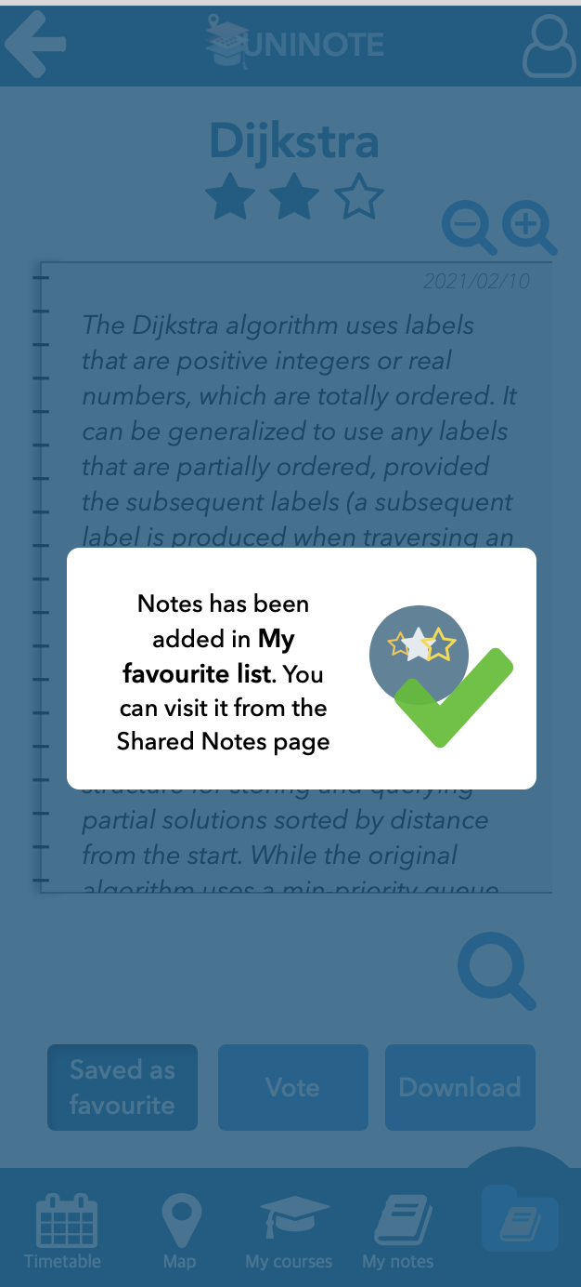

Slide 65
Controlled Experiment (ANOVA): Save note as favourite
Task: the user is reading a note that interests him and he wants to save it as favourite
Participants: 20 people (in a range of age between 19-25 years old according to user profiles)
Variables:
• Independent: the two interfaces
• Dependent: the time in seconds to execute the task
Hypothesis: user will complete the task in less time using the first interface rather than the second one.
The null hypothesis is that there will be no difference terms of time between the first and the second interface.
Assumption: let’s assume the user is already logged in the application.

Slide 66
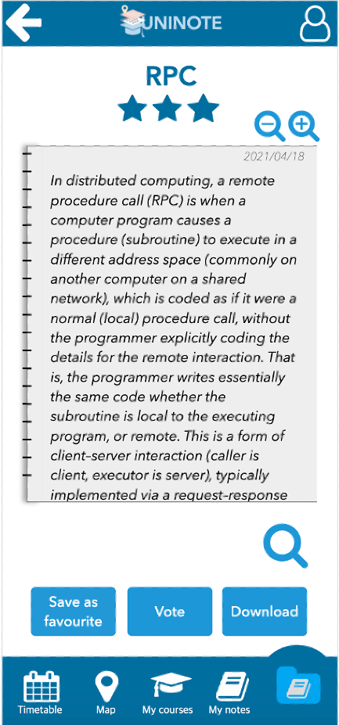
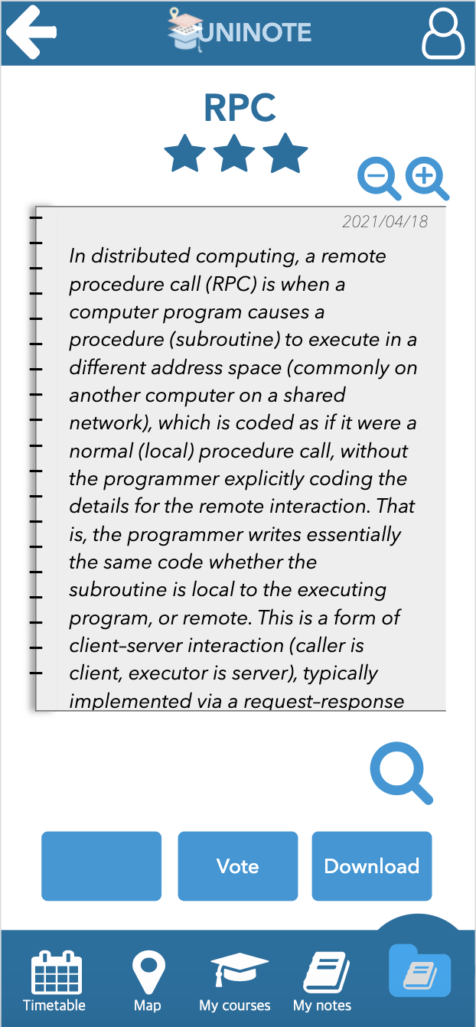

Interface 1:
Interface 2:
(With label)
(Without label)

Slide 67
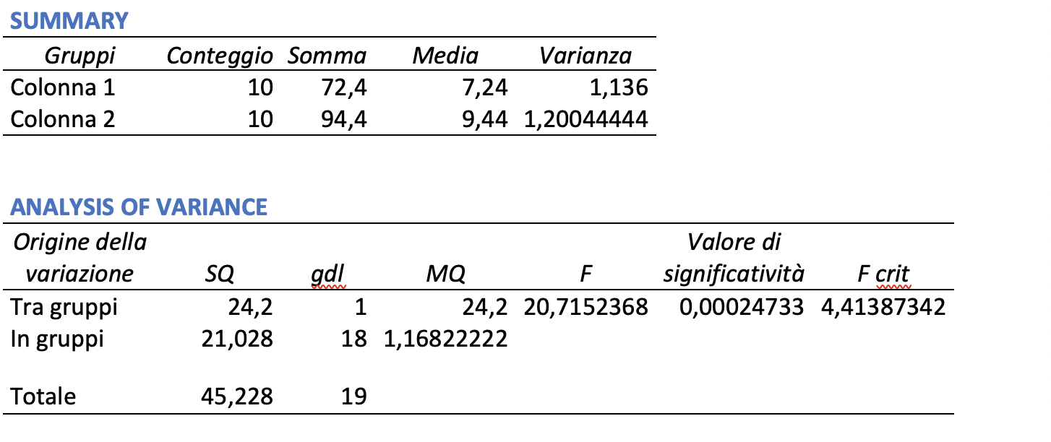
Results
Interface1 | Interface2
7 | 9
6,44 | 8,9
9 | 7
7,2 | 10
8 | 10,3
5,6 | 10
8 | 9
7 | 9,2
6 | 11
8,2 | 10
Table: Time (in seconds) taken to perform the task using two different interfaces.
Since F > F crit (i.e. 20,7152368 > 4,41387342 ), the null hypothesis can be rejected and our hypothesis is true.

Slide 68
Controlled Experiment (ANOVA): Search a building on the map
Task: the user wants to know where a specific building is located on the map.
Participants: 20 people (in a range of age between 19-25 years old according to user profiles)
Variables:
• Independent: the two interfaces
• Dependent: the time in seconds to execute the task
Hypothesis: user will complete the task in less time using the first interface rather than the second one.
The null hypothesis is that there will be no difference terms of time between the first and the second interface.
Assumption: let’s assume the user is already logged in the application.

Slide 69
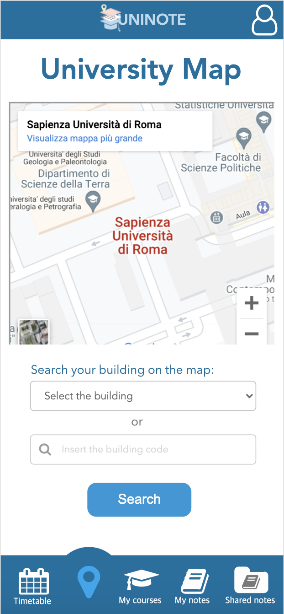
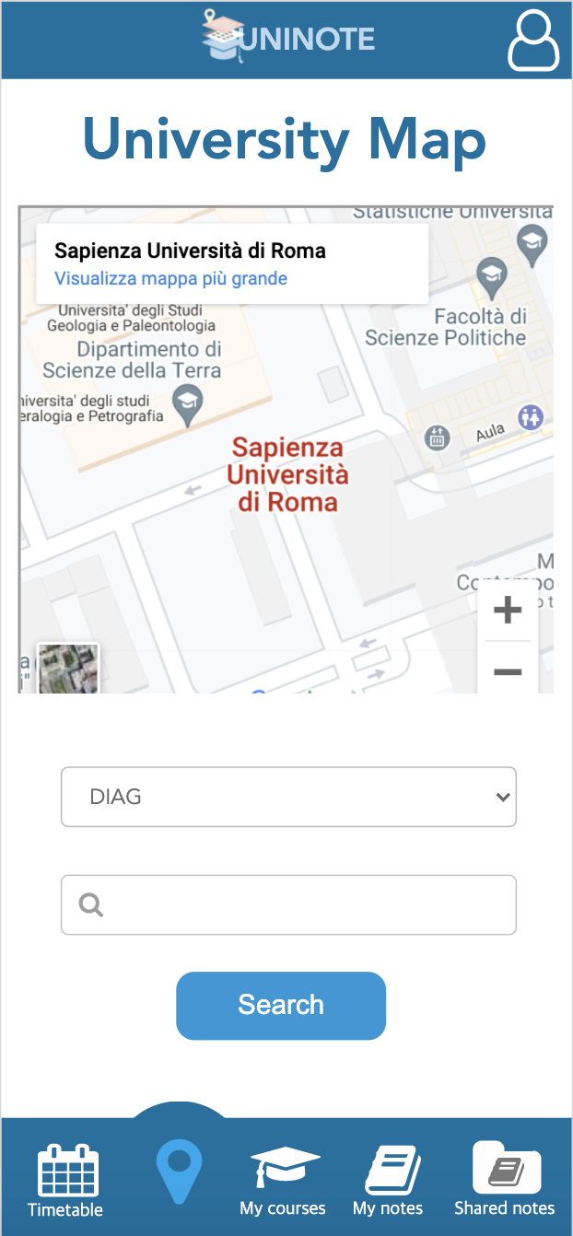
Interface 1:
Interface 2:
(With label)
(Without label)

Slide 70
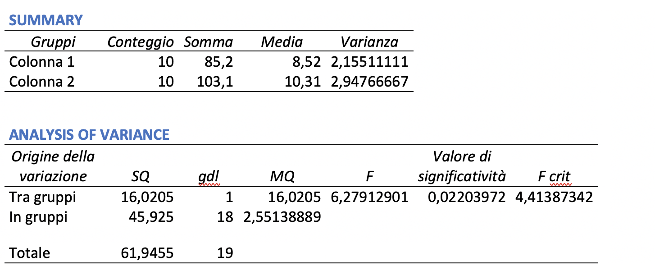
Interface1 | Interface2
9 | 10
8,9 | 8,8
7 | 9
10,3 | 12
10 | 11
9 | 9,6
6 | 14
7 | 9,2
8,3 | 11
9 | 8,5
7,5 | 10
Results
Table: Time (in seconds) taken to perform the task using two different interfaces.
Since F > F crit (i.e. 6,27912901 > 4,41387342), the null hypothesis can be rejected and our hypothesis is true.

Slide 71
Controlled Experiment (ANOVA): Open a course’s details
Task: the user wants to see course’s details (eg.: lessons’s link, reference web page, etc...)
Participants: 20 people (in a range of age between 19-25 years old according to user profiles)
Variables:
• Independent: the two interfaces
• Dependent: the time in seconds to execute the task
Hypothesis: user will complete the task in less time using the first interface rather than the second one.
The null hypothesis is that there will be no difference in terms of time between the first and the second interface.
Assumption: let’s assume the user is already logged in the application.

Slide 72
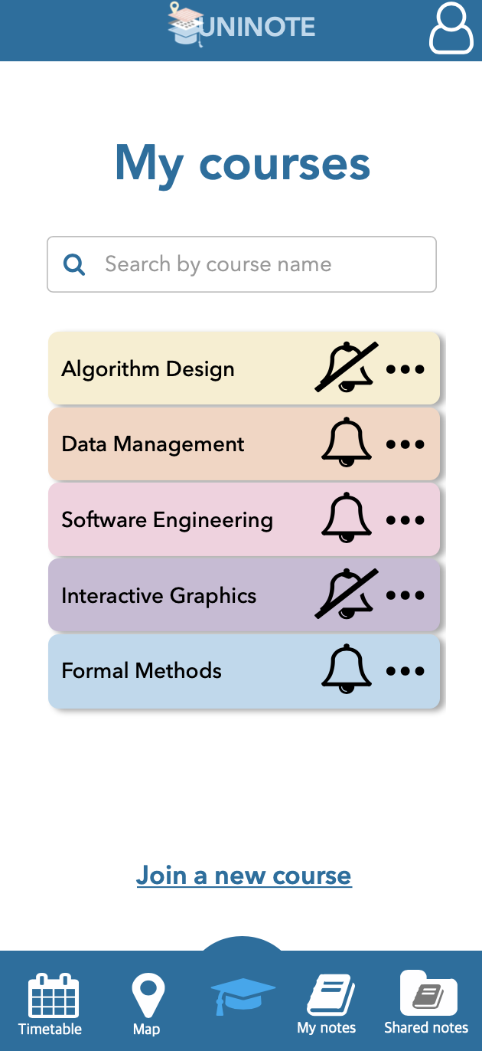
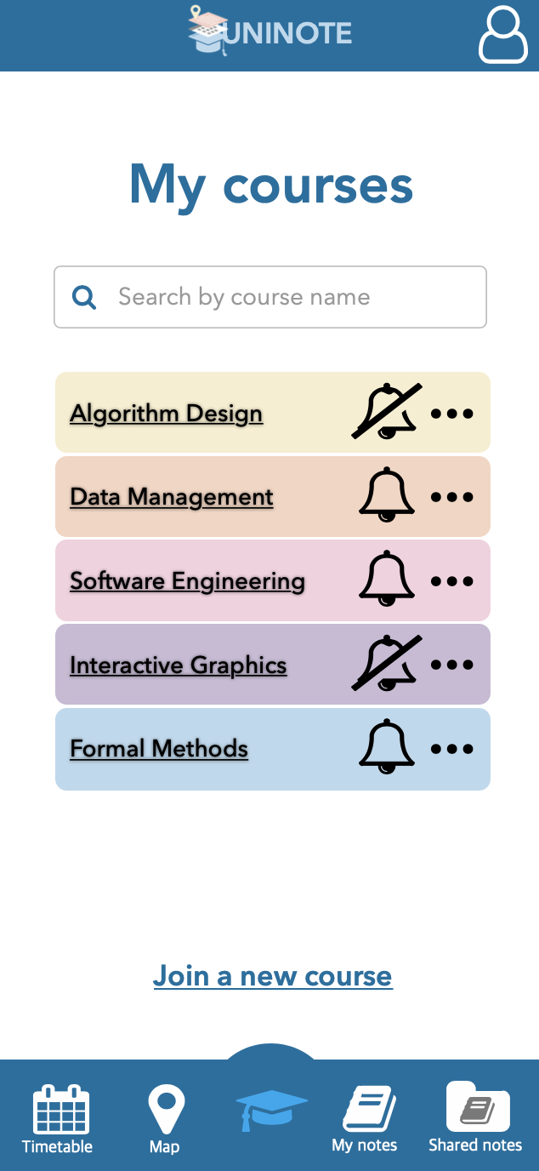
Interface 1:
Interface 2:
(With buttons’ shadows on)
(With underline courses’ names)

Slide 73
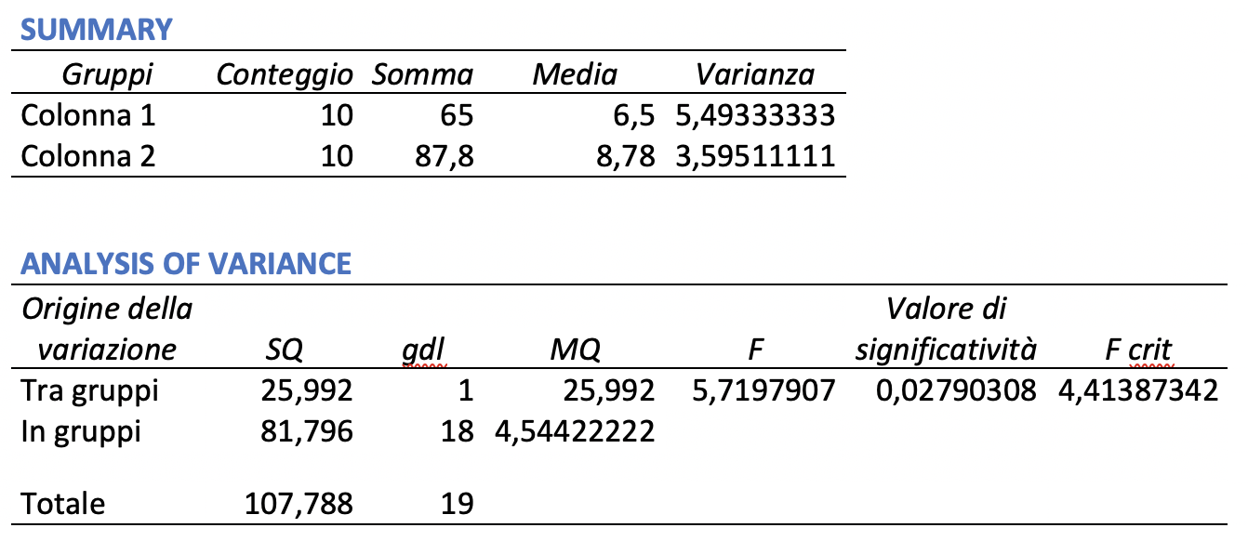
Results
Interface1 | Interface2
3 | 5
8,9 | 8,8
4 | 9
6 | 11
7 | 11
10 | 9,6
8,8 | 10
7,3 | 9,2
4 | 6,8
6 | 7,4
Table: Time (in seconds) taken to perform the task using two different interfaces.
Since F > F crit (i.e. 5,7197907 > 4,41387342), the null hypothesis can be rejected and our hypothesis is true.

Slide 74
PROTOTYPE 3

Slide 75
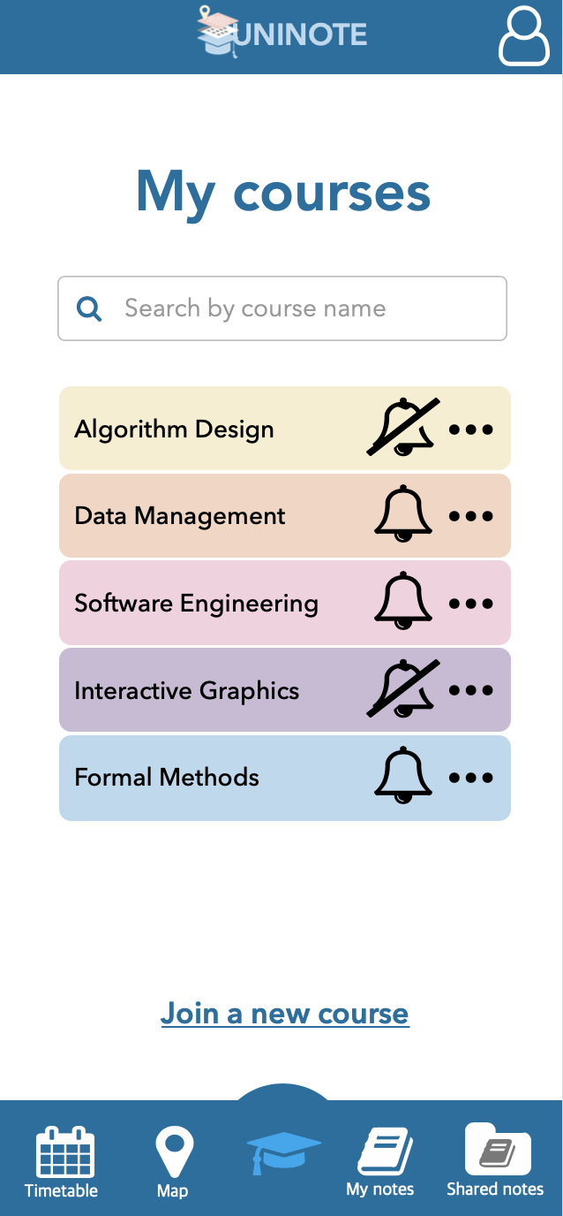
Corrections made after the user based evaluation: fourth prototype
Help the user to understand he can click on the course name to read its details

Slide 76
Corrections made after the user based evaluation: fourth prototype
Help the user to understand what are the link for

Slide 77
Corrections made after the user based evaluation: fourth prototype
Help the user to access the My favorite courses’ list

Slide 78
Corrections made after the user based evaluation: fourth prototype
Provide the user a more comfortable lesson’s schedule

Slide 79
FINAL SYSTEM

Slide 80
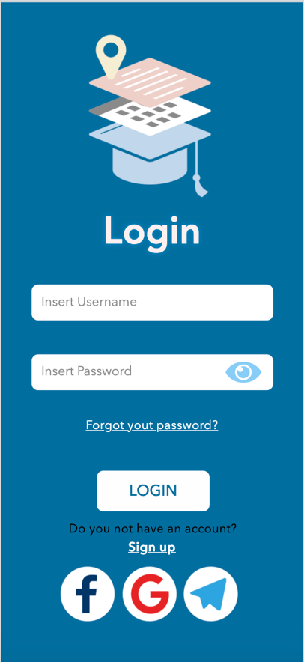
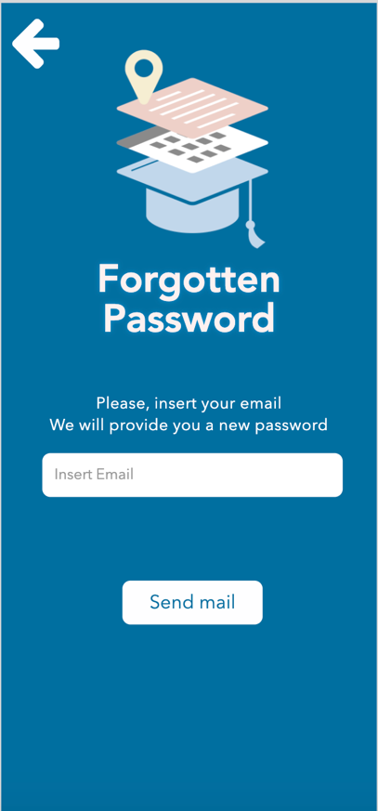
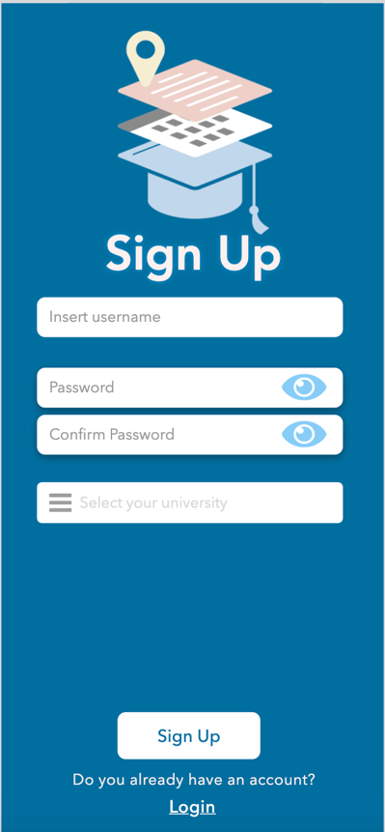
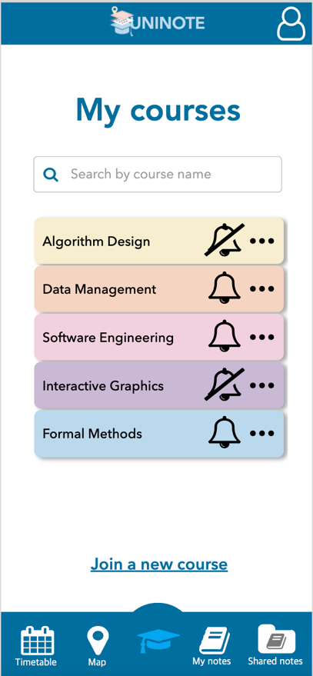

Slide 81
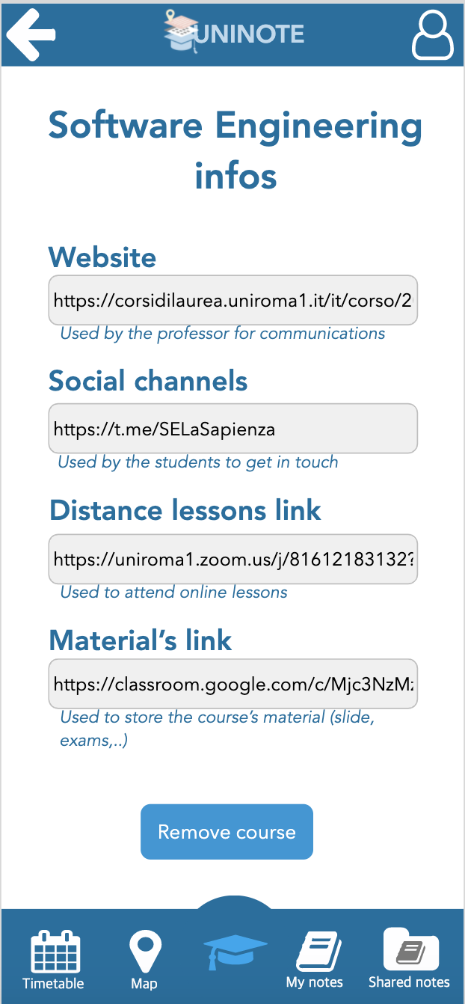
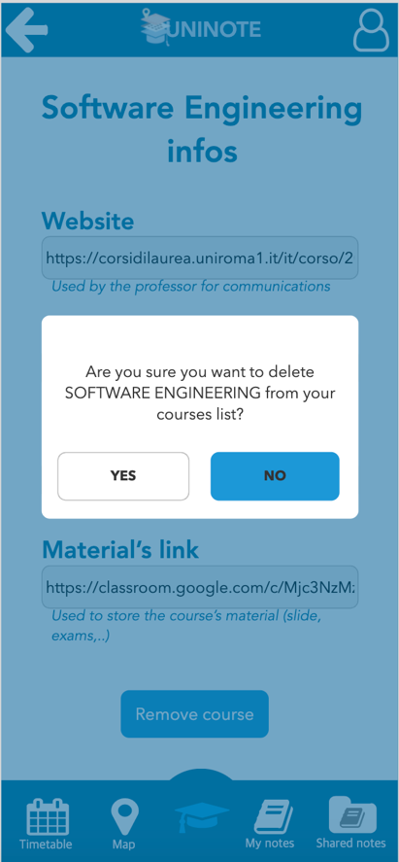
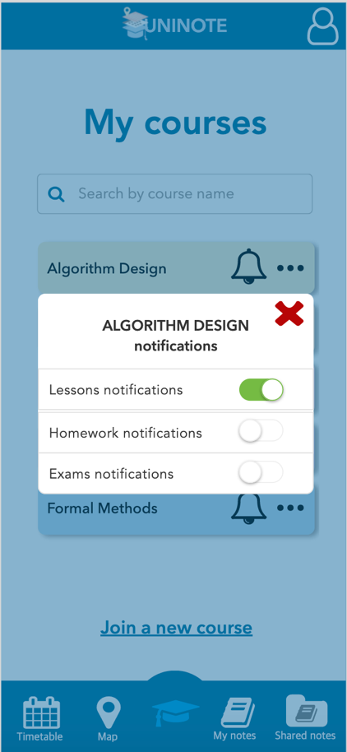
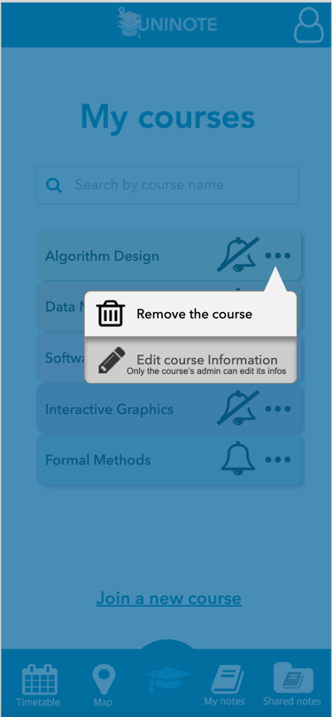

Slide 82
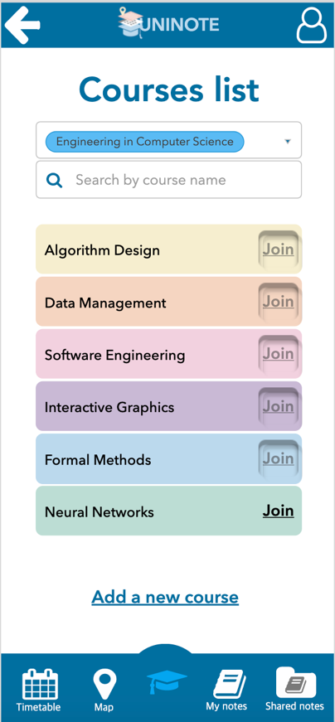
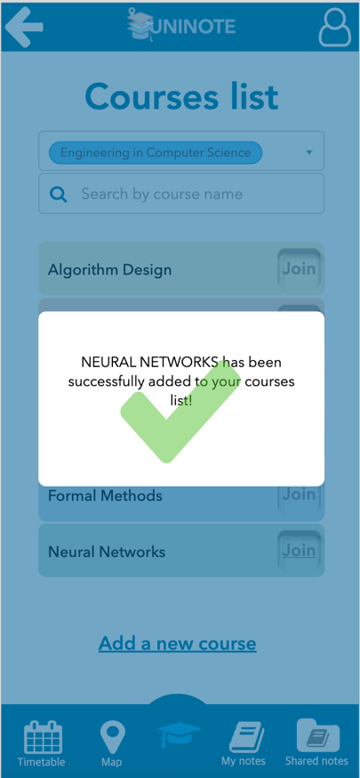
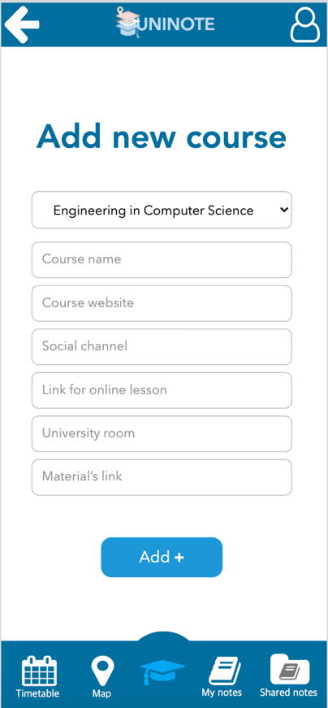
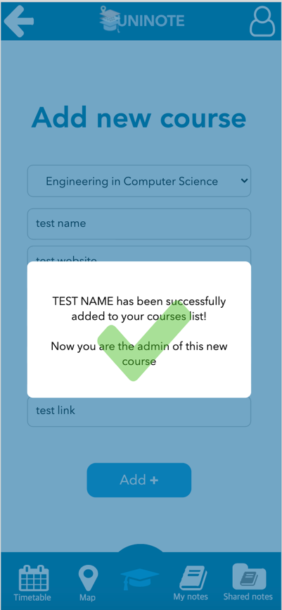

Slide 83
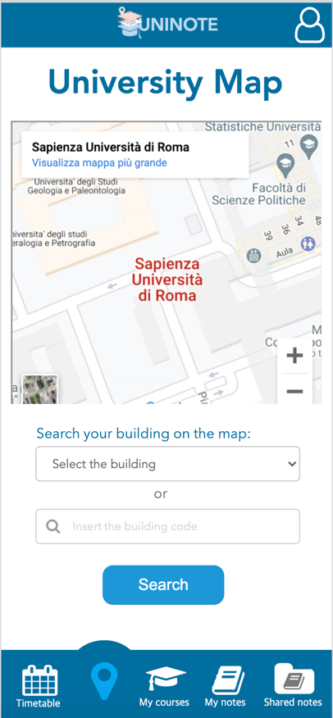
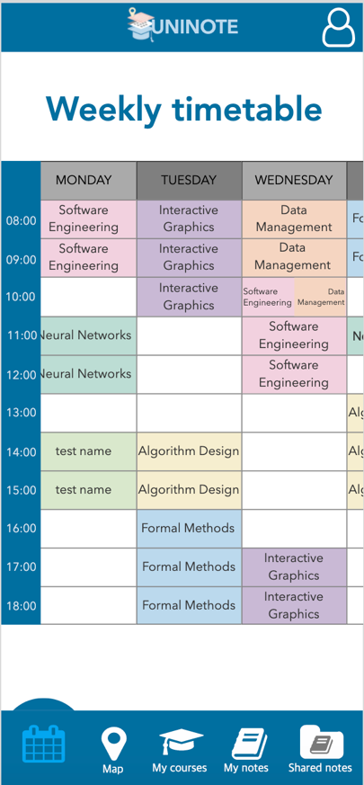
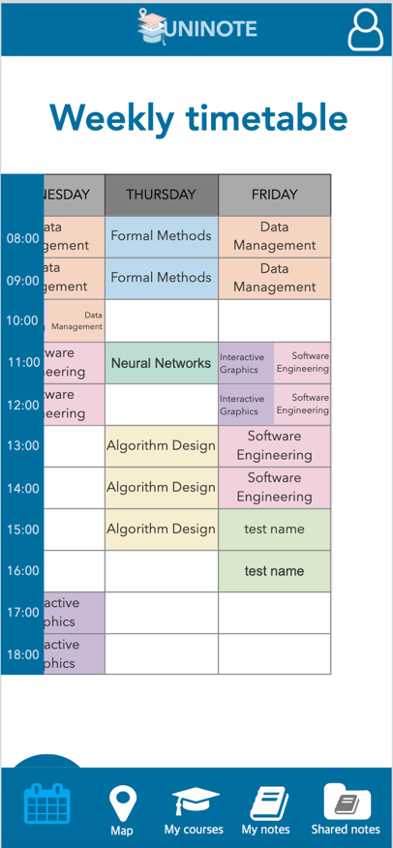
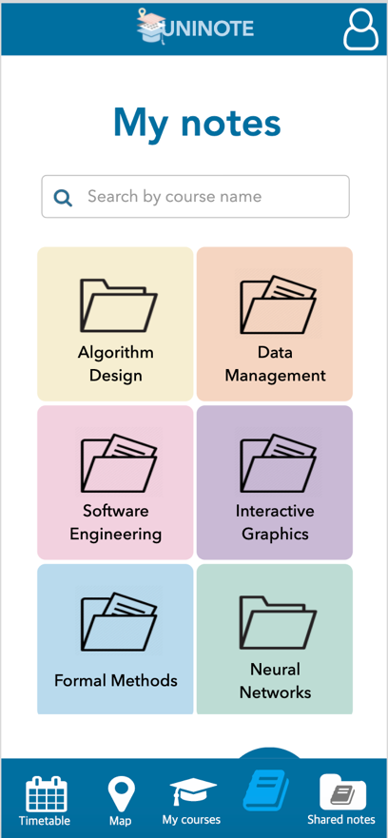

Slide 84
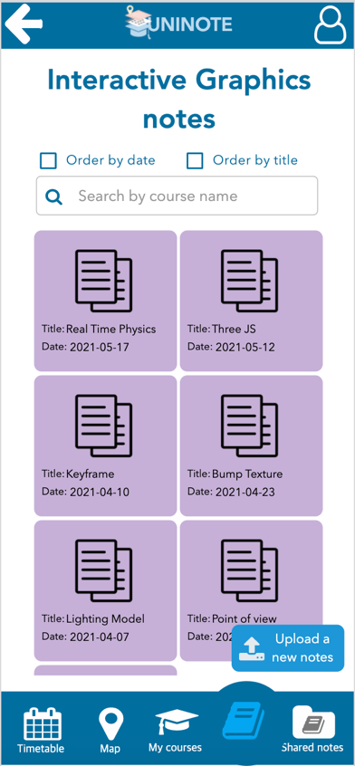
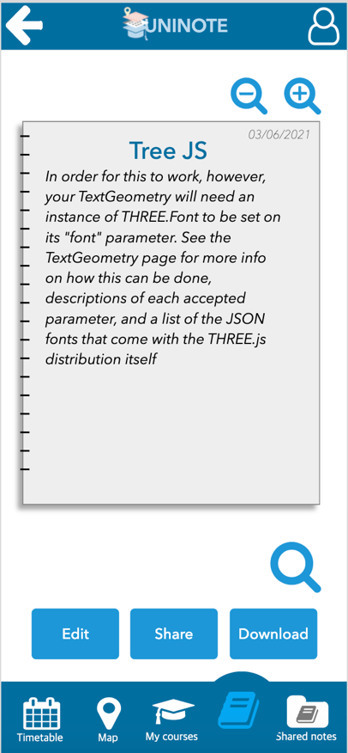
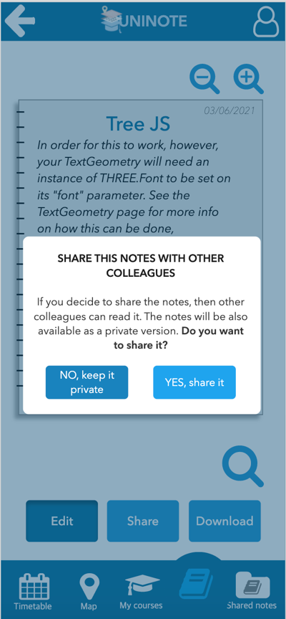
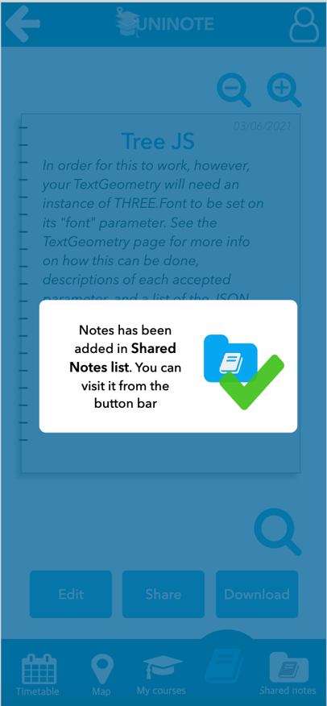

Slide 85
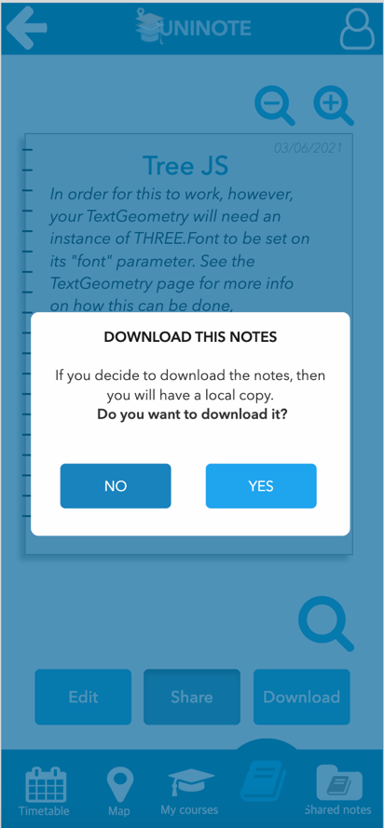
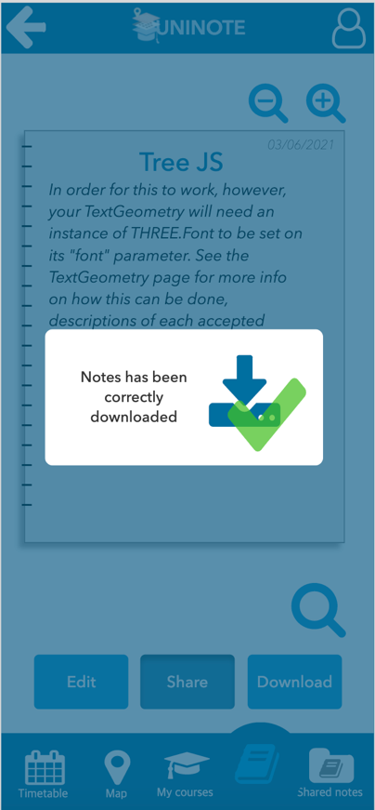
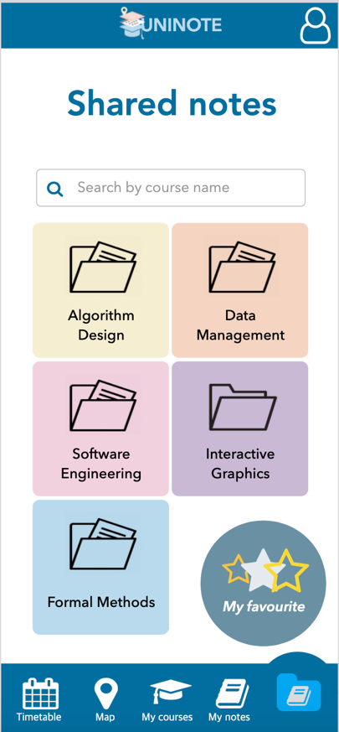
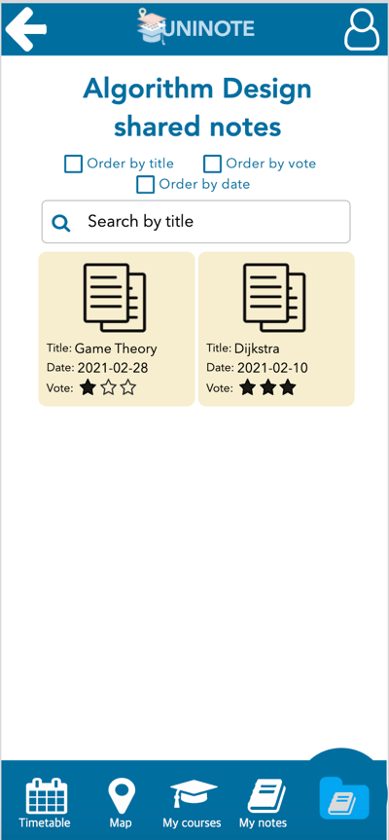

Slide 86





Slide 87




Slide 88

FUTURE WORKS…
Desktop version
More universities
More degree courses
Implement the notification system
Implement more edit functionalities

